Slide 1
HEC Blackburn with Darwen HWBB Priorities
Prof. Dominic Harrison, Director of Public Health
Lancashire and Cumbria Panel 2
Health Equalities Commission
29 November 2021

Slide 2
Overview
The Ask
Our 5 priority areas
Our priority actions (strategic/systems)

Slide 3
The Ask

Slide 4
What sectors do you need to work with to address health inequalities? What do you need to have effective partnerships with businesses, local authorities, CVSFE, communities?
Outside of the funding issues, what support do you need to better addresses the wider determinants of health and health inequalities in Lancashire and Cumbria?
Can you foresee Lancashire and Cumbria Integrated Care Board (ICB) investing in the social determinants in the next 5 years? What support do you need to shift priorities to spending on social determinants and health equity?
What are the main challenges to action on the social determinants and health inequalities?
What are your recommendations for an effective regional system/collaboration on health inequalities?

Slide 5
Agreed priority areas

Slide 6
Priority 1. Early years
Child mortality rate (1-17 years)
High rates of low birth weight and smoking in pregnancy
Third LA with higher child mortality
High rates of tooth decay in children
Source: PHE

Slide 7
Priority 2. Good quality employment and economic growth
Unemployment Apr 2020-Mar 2021; % of the economically active over-16 population
High unemployment
Low wages
Need to foster sustainable and sustainable growth
Source: IHE from ONS

Slide 8
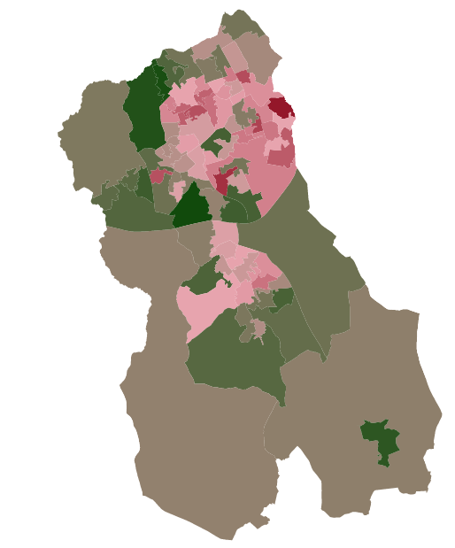
Priority 3. Housing
The private sector has the highest national rate of homes with serious “Category 1” hazards
In some areas of the Borough, up to one third of the houses are fuel poor
Lack of power of Local Authority to enforce standards in HMOs
Estimated proportion of fuel poor households, LSOA 2018/19

Slide 9
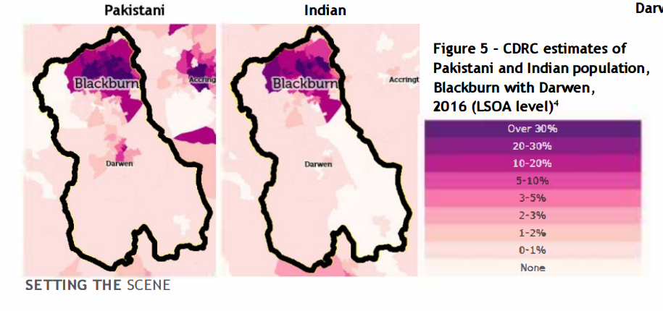
Priority 4. Reducing inequalities in ethnic minorities
One of the LAs with largest % of non-white-British population
These population groups are more likely to suffer deprivation
Inequalities in access to services

Slide 10
Priority 5 Extend Community & Neighbourhood Health Capacity
Developing a neighbourhood based community support system working with PCNs
Notes:
Work is underway to align neighbourhood and community service investments by Local Authorities alongside and within the Primary Care Neighbourhoods. This will provide an out of hospital community infrastructure to support recovery and independence for those with LTCs and complex care needs. SharedLives have developed the attached ‘ideal model’ to describe this.
Many are now calling such development – the development of recovery communities (i.e. supportive social infrastructure where people with LTCs complex needs are supported to recover independence and increase resilience– but are not necessarily ‘cured’ of the disease!
Some of this is in place but additional VCFS and neighbourhood funding is required as part of the £3m per year asked for.

Slide 11
Agreed Priority Actions New ‘Systems and Capacities’ (not just more programmes) (but those too!)

Slide 12
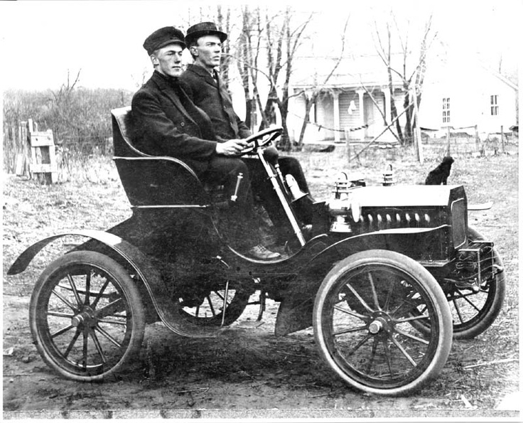
Building Back Fairer & Make the NHS Sustainable Moving from ‘Detect and Manage’ to ‘Predict and Prevent’
“Preventable ill-health accounts for an estimated 50% of all GP appointments, 64% of
outpatient appointments and 70% of all inpatient bed days.”

Slide 13
Modernise Governance Models
Move to ’Smart Governance’.
Governance of Health (actions by and directed towards the NHS health care system; namely, its policy, expenditure and decision-making)
Governance for Health (governance of health outcomes (both intended and unintended) relating to policy, expenditure and decision-making across the whole of government and society (that is, in the non-health sphere as well as in the health sector).
Characteristics of ‘Smart Governance’:
1. governing through collaboration
2. governing through citizen engagement
3. governing through a mix of regulation and persuasion
4. governing through independent agencies and expert bodies
5. governing through adaptive policies, resilient structures and foresight.
“Smart governance for health” therefore embodies a combination of these characteristics. in the strategic approach to addressing health challenges, including reducing inequities in health as whole-of-government and whole-of-society approaches.
Kickbusch et al

Slide 14
Reinforce local/regional capacity
Ensure local authorities have the power to modify local determinants of health
Use local assets to promote well-paid work and sustainable economic growth

Slide 15
Establish robust health equity delivery mechanisms
Strong leadership
Define the right levers and incentives
Embed capabilities within communities
Implement performance management systems
Ensure regular and continuous feedback and evaluation

Slide 16
Are our health equity delivery mechanisms fit for purpose ?

Slide 17
An effective health equity delivery system – systems characteristics

Slide 18
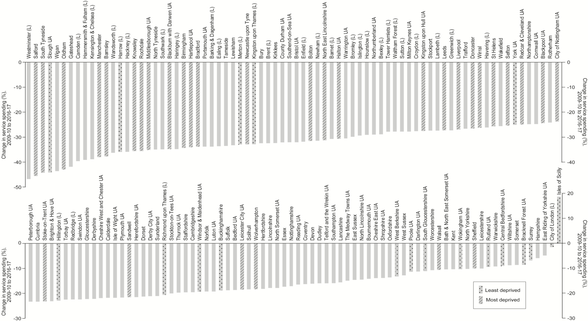
Levelling up Local Authority Funding
Local Authority Service cuts -152 upper-tier authorities in England
Between 2009/10 to 2016-17.
(80% of Local Government spend is on 5% of the most vulnerable population?)
From: The depths of the cuts: the uneven geography of local government austerity
Cambridge J Regions Econ Soc. Published online October 09, 2018. doi:10.1093/cjres/rsy019
Cambridge J Regions Econ Soc | © The Author(s) 2018. Published by Oxford University Press on behalf of the Cambridge Political Economy Society. All rights reserved. For permissions, please email: journals.permissions@oup.comThis article is published and distributed under the terms of the Oxford University Press, Standard Journals Publication Model (https://academic.oup.com/journals/pages/open_access/funder_policies/chorus/standard_publication_model)
Notes:
Figure 8. Changes to English Local Government service spending, 2009–2010 to 2016–2017. The spending data show real terms change in service spending, excluding spending on the police, fire, public health, education and social care. Note that the smallest reduction and only rise in service spending were in the Isles of Scilly and the City of London respectively, which are ‘sui generis’ (unique) authorities due to functioning as a Unitary Council despite having extremely small populations (Sandford, 2017). Data source: Institute of Fiscal Studies, Amin-Smith et al., IFS, 2016, and the English Indices of Deprivation 2015 (Department for Communities and Local Government, 2015).
18

