Slide 1
Blackpool Health and Wellbeing Board HEC Panel Meeting
29 November 2021

Slide 2
Blackpool “The Watering Hole of the Masses”

Slide 4
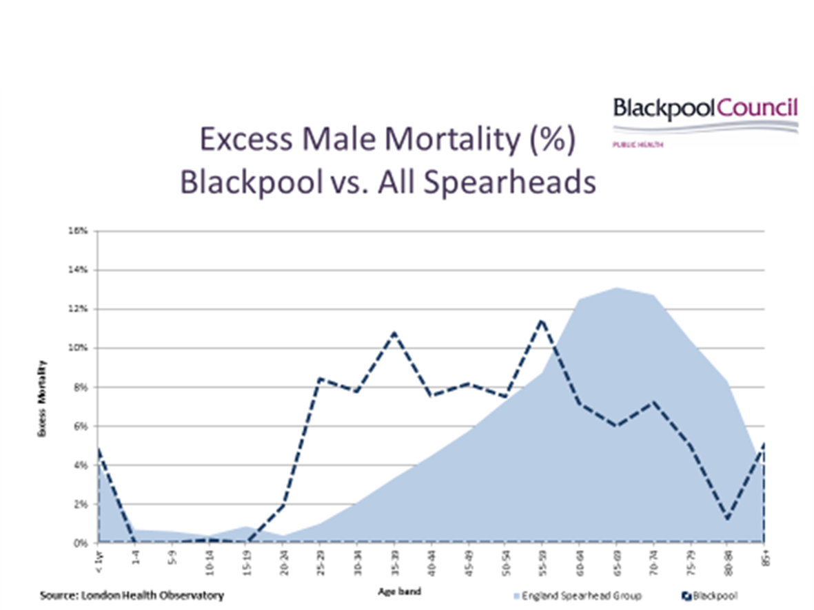

Slide 5
Q1: What sectors do you need to work with to address health inequalities? What do you need to have effective partnerships with businesses, local authorities, CVFSE, communities?
Well yes! And we do.
Business in the Community
Blackpool Pride of Place, Claremont Steering Group
Grange Park Community Forum
Fairness Commission
NHS Primary Care Networks
VCSF and Community Collaborative Engagement Group
Regional and Lancashire wide NHS and Local Authority Partnerships –climate change, green energy/Affordable warmth
Partnership Boards representing the most vulnerable – changing futures, drug related death, learning disability, mental health

Slide 6
Q2: Outside of the funding issues, what do you need to better address the wider determinants of health and health inequalities in Lancashire and Cumbria?
Agree a few key priorities and jointly invest
NHS to respond to need rather than demand
Provide services in a way people in real need want to access it, stop providing services from a professional tribe or organisational perspective
Do what we did during COVID with the homeless, rip up the rule book, forget criteria and putting hurdles in place to access services. Listen and harness those with lived experience.

Slide 7
Q3: Can you foresee Lancashire and Cumbria Integrated Care Board (ICB) investing in the social determinants in the next 5 years? What support do you need to shift priorities to spending on social determinants and health equity?
The NHS has a bad track record!
Fylde Coast Prevention (Health Inequalities) Strategy – 5 to 10 year multimillion pound programme for Blackpool – evidence based key priorities for recurrent investment:-
year 1 – a small amount into smoking and homelessness,
year 2 - transfer the money to the Vic.

Slide 8
Q4: What are the main challenges to action on the social determinants and health inequalities?
Government Policy
Housing, poverty, injecting rooms to name but a few

Slide 9
Q5: What are your recommendations for an effective regional system / collaboration on health inequalities?
1. Set and Invest In priorities
Agree 1 short (hypertension or depression), 1 medium (alcohol/tobacco), 1 long term priority (best start in life) underpinned by recurrent investment in Lived Experience and the third sector.
Why not recreate the old joint finance system, where we have a shared pot we use to fund 3 year change projects.
2. All sign up to meet need rather than demand
Stop saying they keep using the hospital as primary care, we need a campaign to educate or a barricade. It doesn’t work!
Fundamentally review services for groups with the greatest need and worst access to the system that we created. Give parity in the redesign process to those with Lived experience of our inaccessible services
3. Why are we creating a parallel public health and population health system – lets take stock and think again

